Slide 1
Coronavirus (COVID-19) Prediction Using Modified SIR Model
Anh (Tony) Nguyen

Slide 2

Outline
Introduction and Exploratory Data Analysis (EDA)
Experimental Analysis
Model Evaluation
Conclusion
References

Slide 3
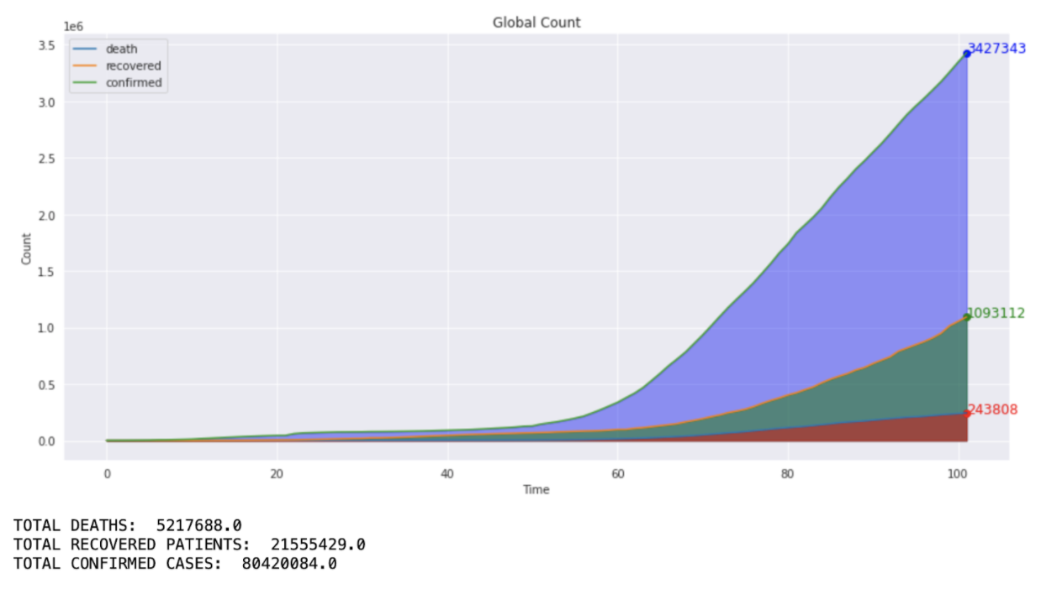
Introduction and EDA
Data Source: Kaggle Novel Corona Virus 2019 Dataset [1]
Figure 1: The number of COVID-19 death, recovered and confirmed cases

Slide 4
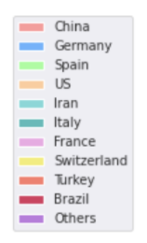
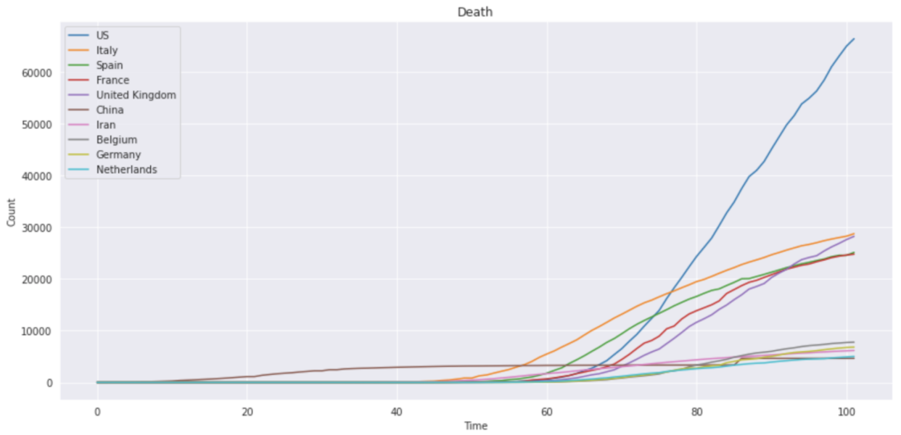
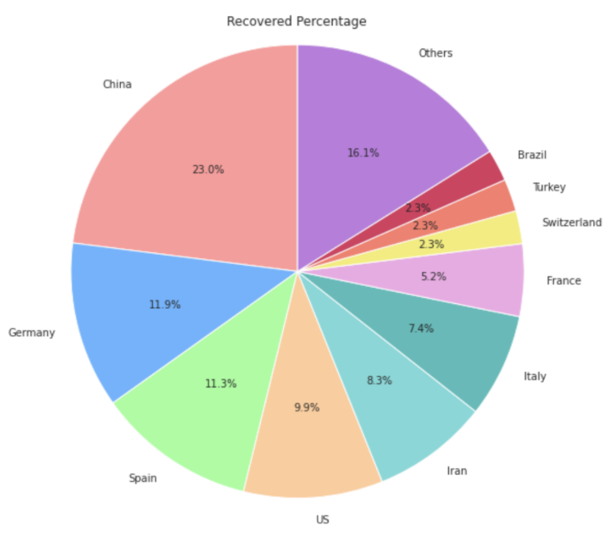
Figure 2: Top 10 countries having the highest death, recovered and confirmed cases
Figure 3

Slide 5
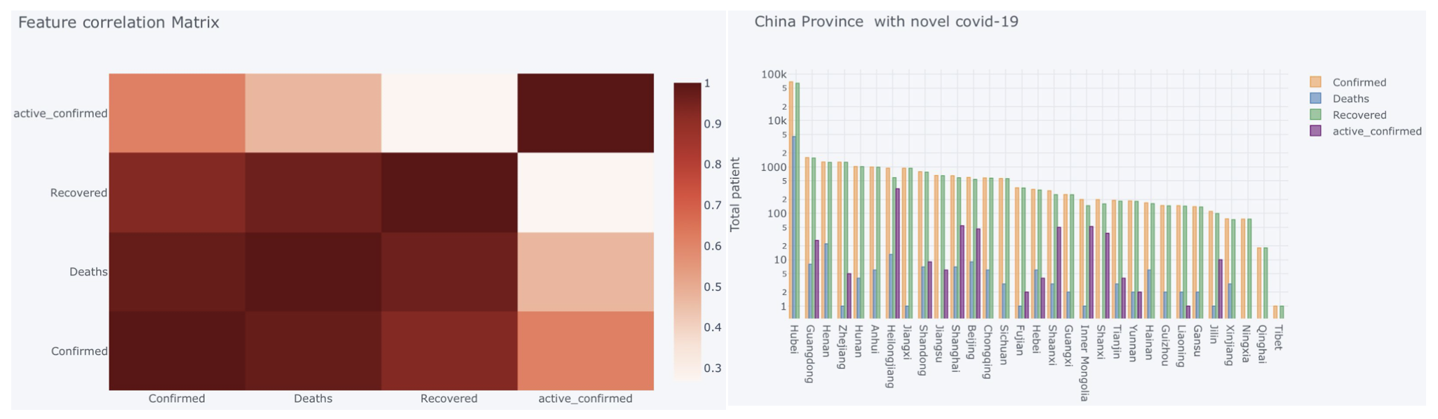
Figure 4
Figure 5

Slide 6
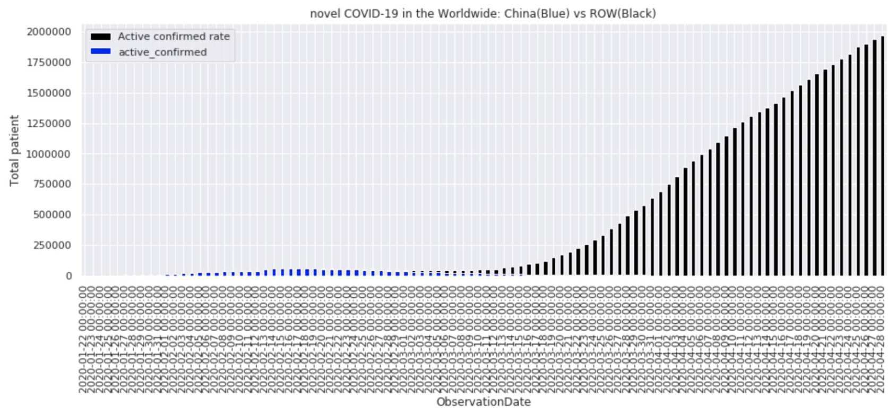
Figure 6

Slide 7
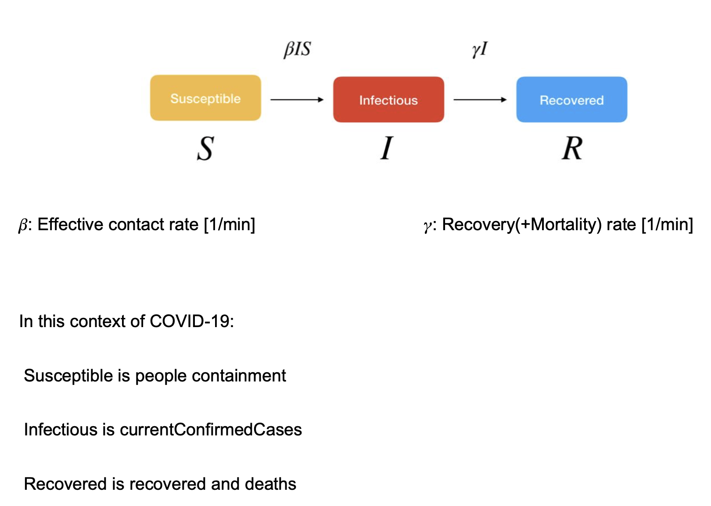
2. Experimental Analysis

Slide 8
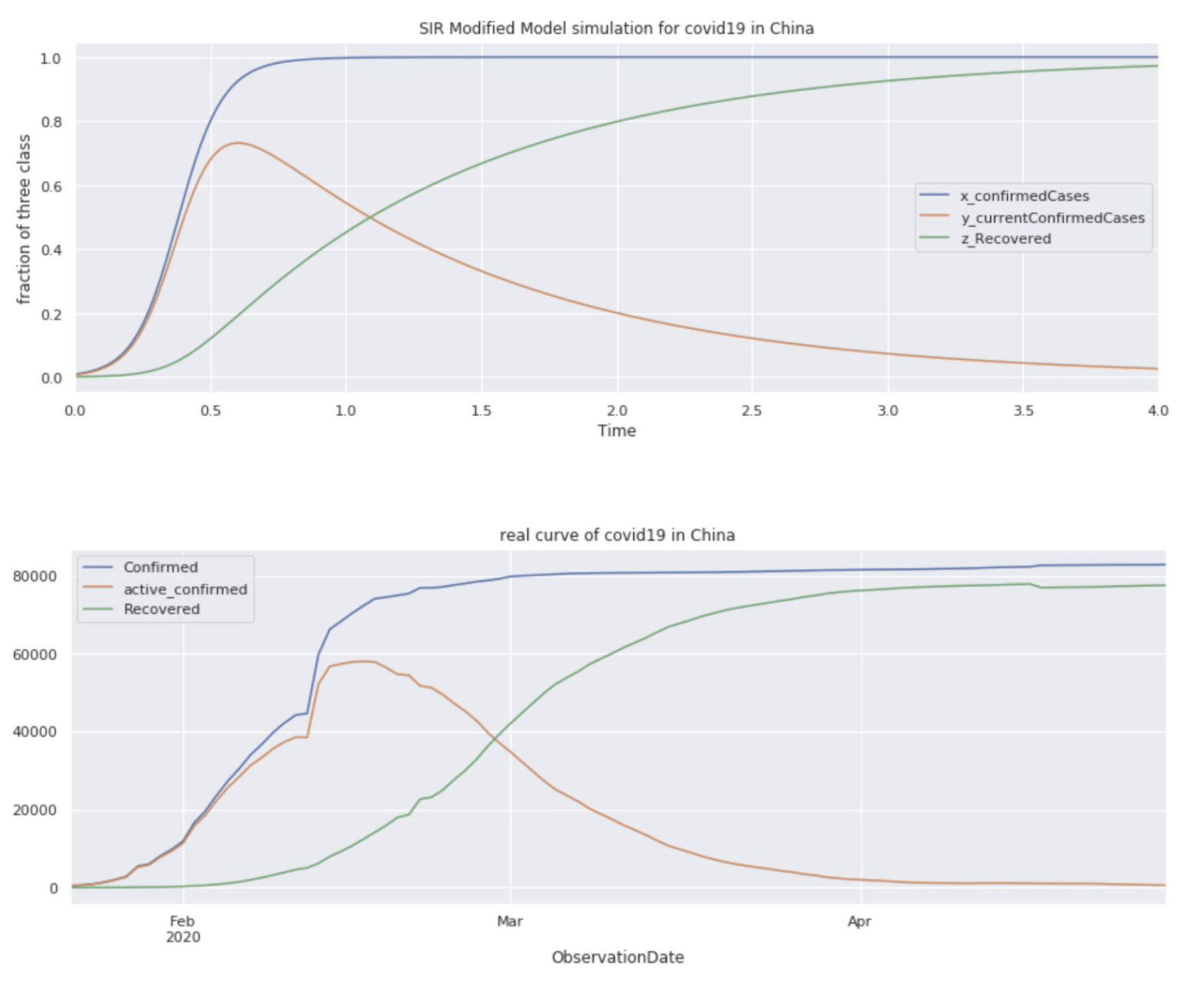
3. Model Evaluation
Figure 7

Slide 9
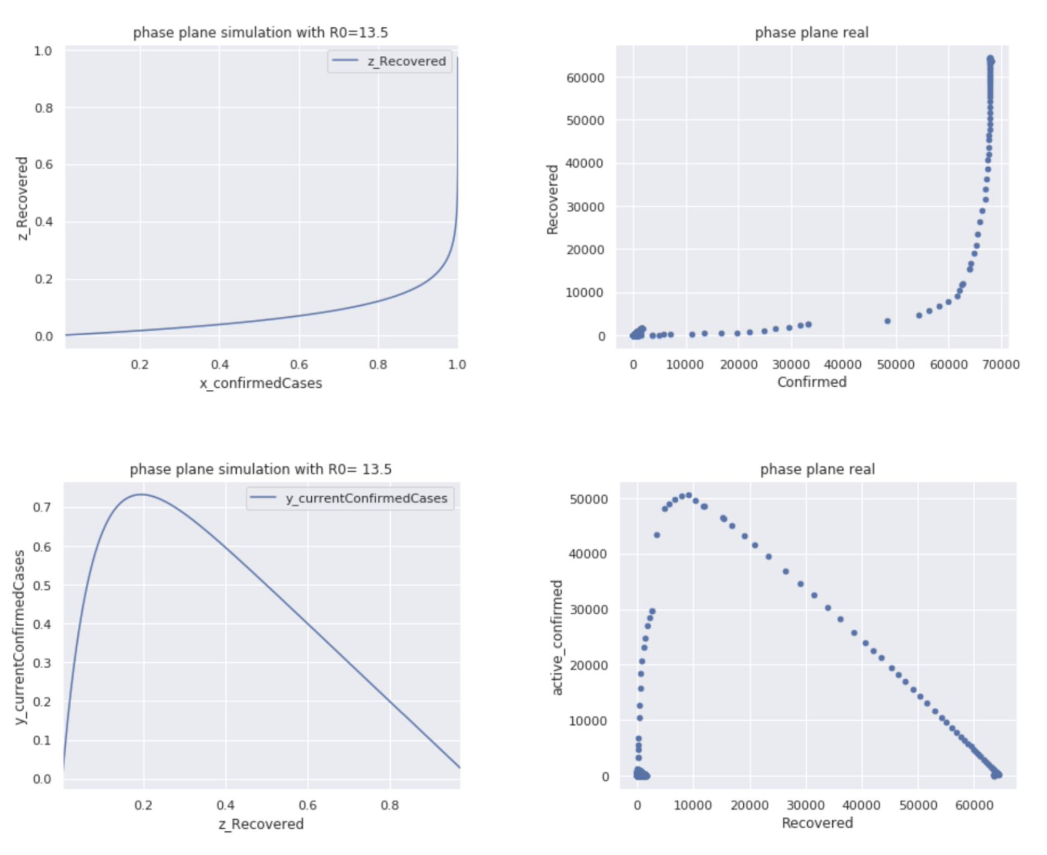
Figure 8

Slide 10
4. Conclusion
Our Modified SIR Model might explain well the COVID-19 control in China with minimal differences if compared to the real results extracted from the Novel Coronavirus dataset.
Future Improvements

Slide 11
5. References
[1] https://www.kaggle.com/sudalairajkumar/novel-corona-virus-2019-dataset
[2] All Figures are from Anh Nguyen’s Github:

Slide 12
Thank you!
Any Questions?

